Slide 1



FLAMINGOLINO
Study together with friends
FIT FOR FINALS WITH INGO!

Slide 2
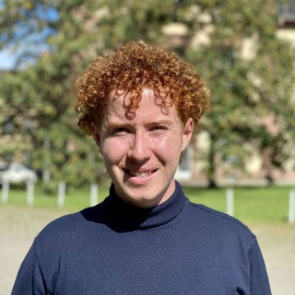
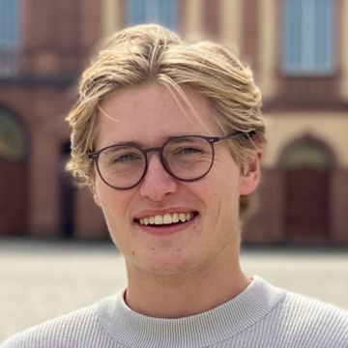
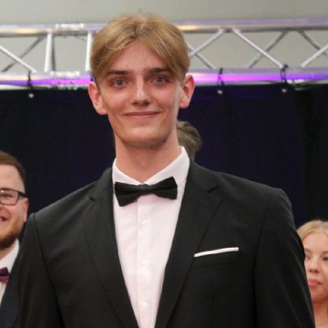
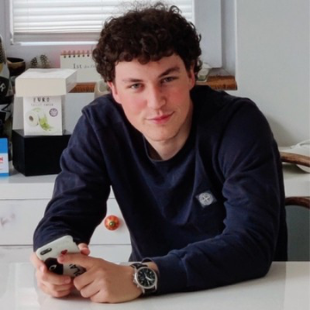
OUR TEAM
Carl Seela
Timo Engler
Marlon Grabeleu
Konrad Matthies
B.Sc Business Informatics
B.Sc Business Informatics
B.Sc Business Informatics
B.Sc Business Informatics

Slide 3
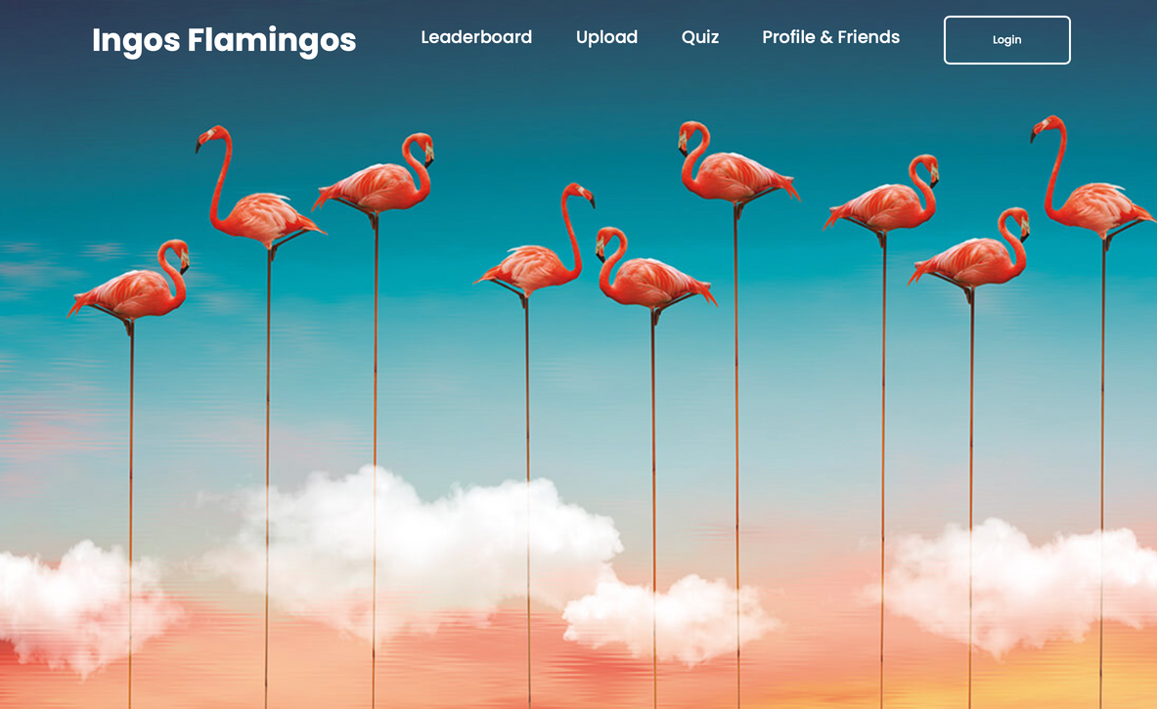

IDEA AND FUNCTIONS
Flamingolino harnesses the potential of GenAI for students and gamifies the studying experience...
FUNCTIONS
AI GENERATED QUIZZES
PLAY AGAINST FRIENDS
LEADERBOARD
FUN COMPETITION

Slide 4
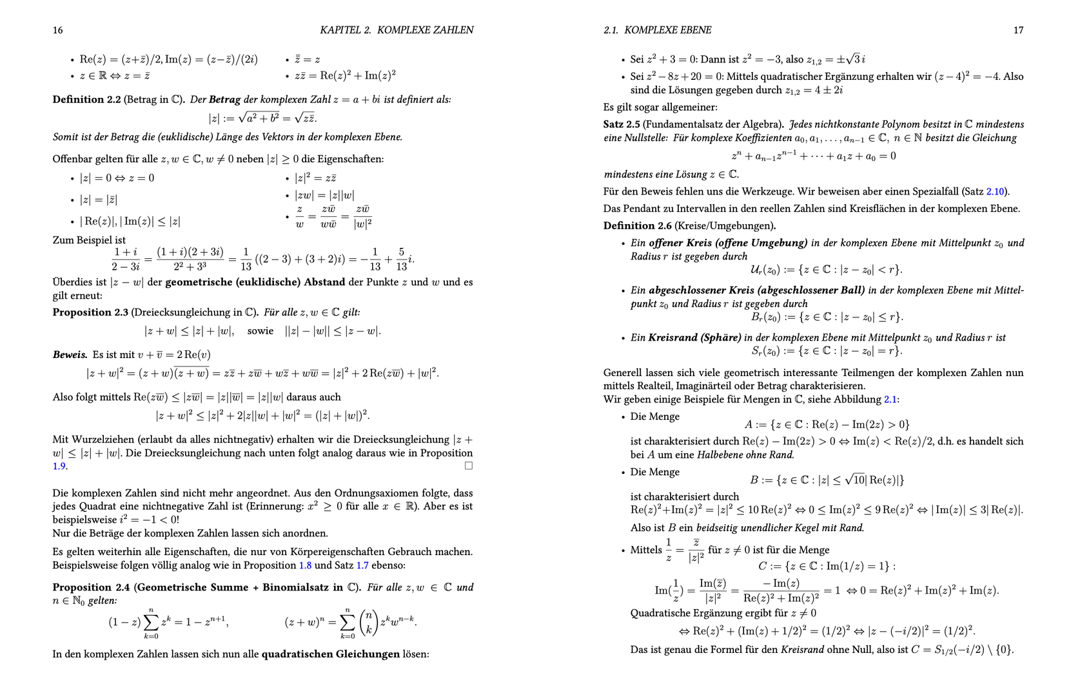

Slide 5
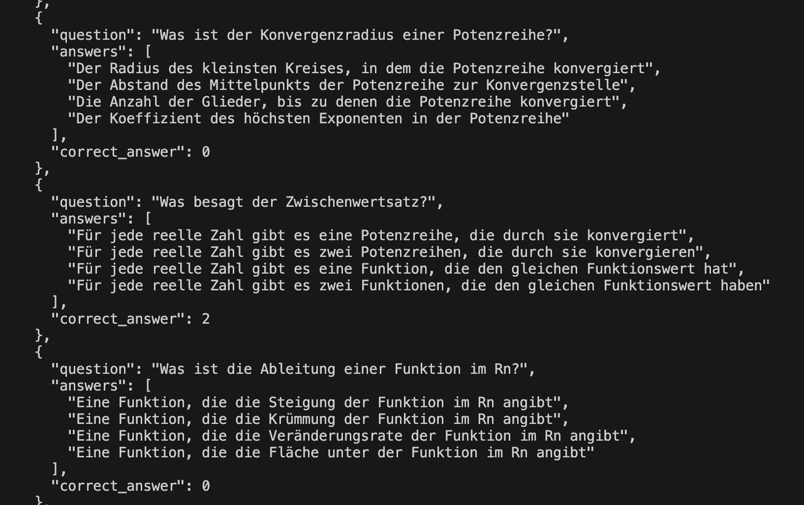

Slide 6
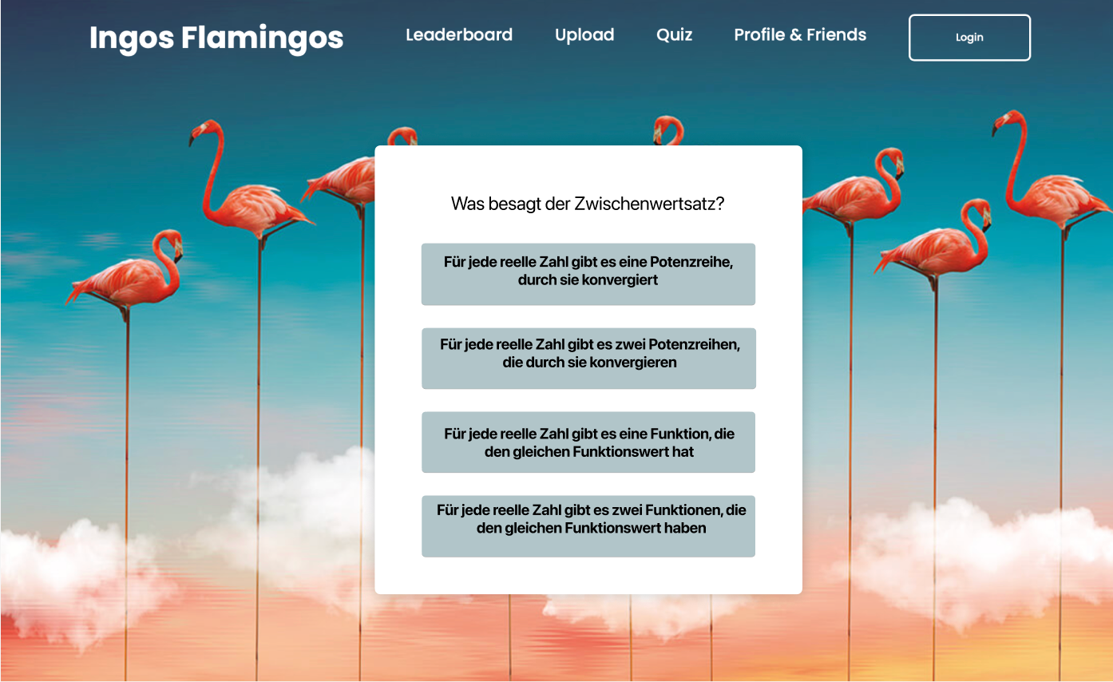

Slide 7
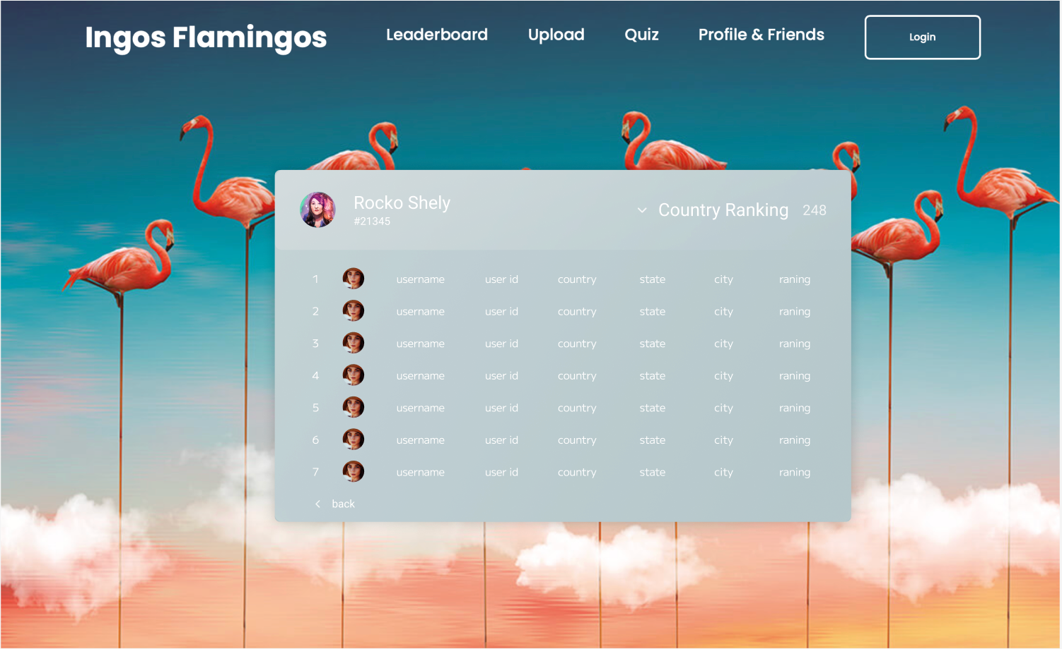

Slide 8



In the process of completing our project we went through severall phases
Project Approach
CONTENT
RESULT
PHASE
Idea collection each for themselves to get as many different ideas as possible
Presentation of all ideas in collaborative discussions to seperate useful ideas
and less relevant ones
Creation of a notion to better understand thought processes later and to have a
common guideline
Identify the
strategy for the app
and create a foundation
1. BRAINSTORMING
Gaining overview over requiered technologies and frameworks
Deepdive into fundamental concepts needed for implementation
Merging the sketches with functions
Gaining skills in new
technologies
2. LEARNING
Splitting the team into frontend and backend for efficiency
Iterative development process through trial and error
Claiming each small win instead of only focusing on end goal
AI implementation
that works with
our scripts
3. IMPLEMENTATION

Slide 9



There were several Challenges that arose while working on the project
SOLUTIONS
3
1
No experience with web development
No knowledge about python
✓ First experience in a professional
work environment
✓ LLM integration
✓ Hands on experience with CSS,
JS and HTML
✓ Deep understanding in Microsoft
Azure and A.I. Modelling
4
Not familiar working with GenAI API‘s
2
No experience with frontend backend development

